Slide 1
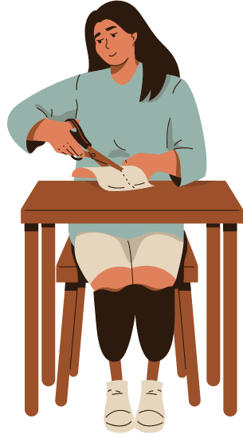
DIY Innovates

Slide 2
01
Material and Tool Sourcing
02
Impact on Creativity
Problem Statement
03
Starting Challenges
04
Confidence Barrier
05
Need for Accessibility

Slide 3
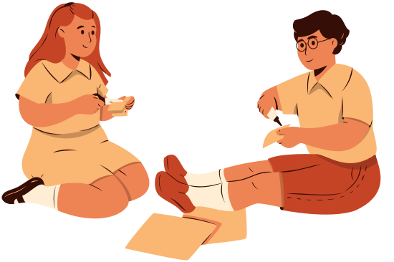
Introduction
Creativity Hub
Project Variety
Offers a diverse selection of products for various fun projects.
Explore products like card making, photo frames etc.
Instant Support
Video Guides
Online chat system available for immediate assistance.
Step-by-step video tutorials are available to guide.

Slide 4
Objective
Diverse Project Range
Video Tutorials
Online Chat Support
Online Shopping
Secure Payment Gateway

Slide 5



SCOPE
Creators
Students
Guardians

Slide 6
Modules
Authentication
System
DIY Package
Manager
Cart System
Video Streaming
System
Package Searching
System
It acts like a special key to ensure only authorized users can access our crafting website, providing a secure and personalized experience.
Package manager is about empowering users to seamlessly manage.
It is an online feature that allows users to add, manage and organize selected items before proceeding to the checkout.
It is a platform or service that enables the delivery and playback of videos over the internet, allowing users to watch content in real time without the need of downloading.
It is a feature that allows users to search and find specific packages or items within a system or platform.

Slide 7
Modules
Review & Rating
System
Payment Gateway
Ordering System
Animation Handler
User Dashboard
It is a feature that allows users to share their feedback and rate products or services.
It handles the transfer of payment data between customers and e-commerce website online, ensuring safe and seamless transaction.
It is an online mechanism that enables users to place requests for products or services, facilitating a structured process for businesses to manage and fulfill customer orders.
It is a system that manages and controls the display and behavior of animations in software or web applications, enhancing the visual experience for users.
It is a personalized interface for individual users, presenting key information, settings, and features in a centralized and user-friendly manner for easy navigation and interaction.

Slide 8
Proposed System
Authenticate
User Dashboard
Video Tutorial
Cart System
Ordering
Payment
Review

Slide 9
Feasibility Study
Operational
Technical
Financial
1
2
3
Friendly user interface which is easy to use for non technical user
We use javascript and its libraries that are capable and up to date.
It is a affordable and run fast at every platform.

Slide 10
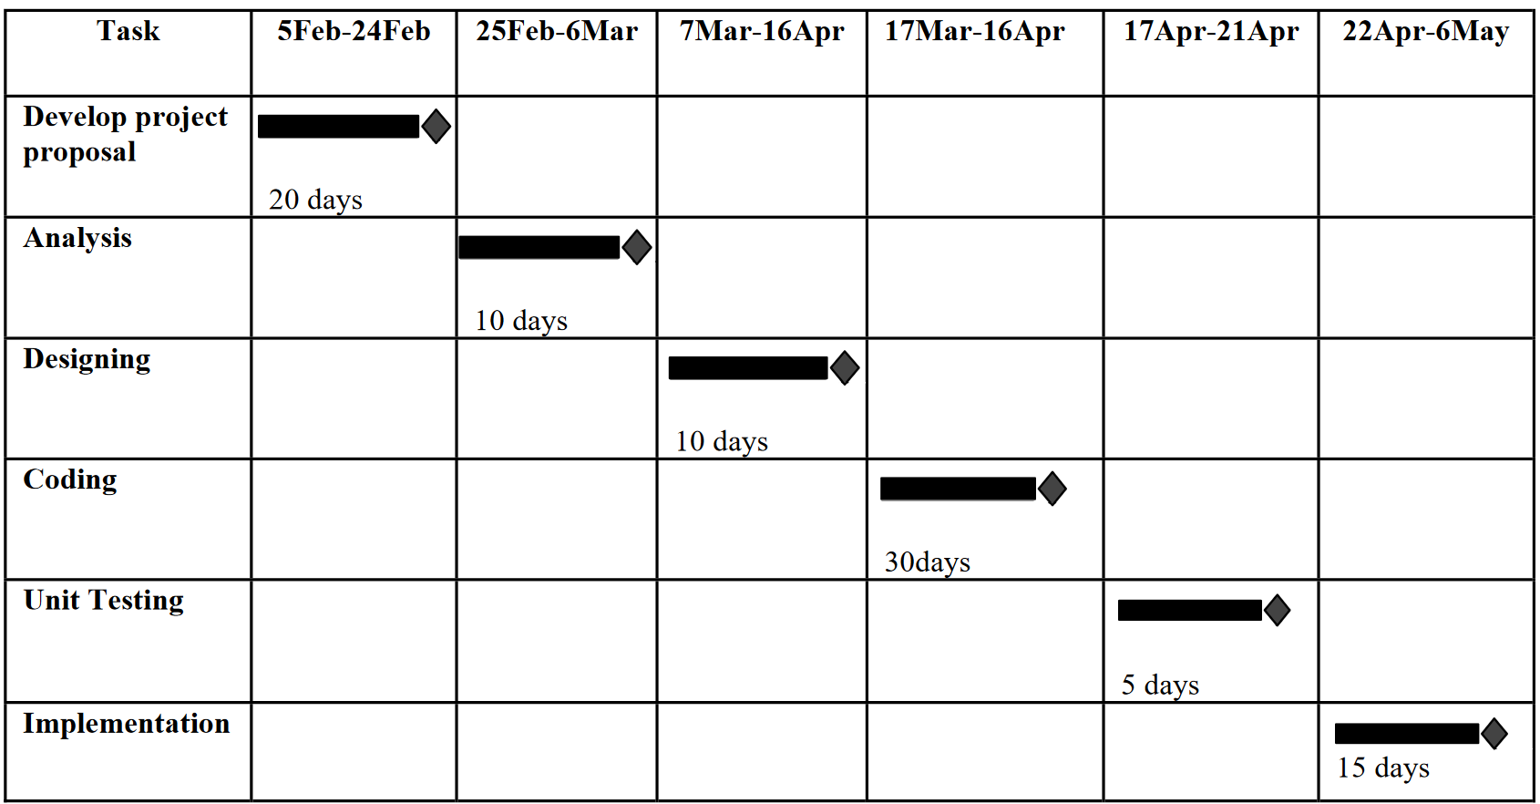
Gantt Chart

Slide 11
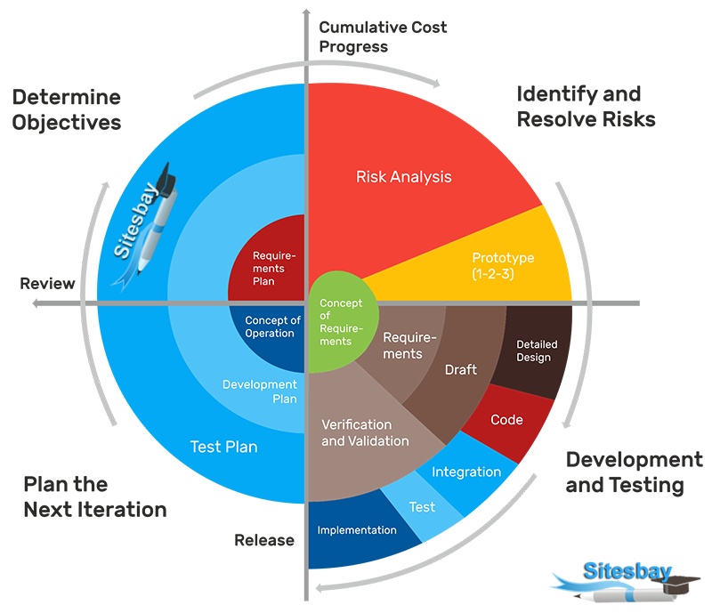
Spiral Model
The Spiral model is a risk-driven software development process model.

Slide 12
Hardware Requirements
Client Side
Processor | Dual Core or above
RAM | 4 GB
Disk space | 256 GB (SSD)
Monitor | Desktop/laptop/ tab/ mobile
Network Other | Internet Connection Keyboard/mouse
Developer Side
Processor | Quad Core or above (2 GHz or more)
RAM | 8 GB or above
Disk space | 500 GB (SSD)
Monitor | Desktop/Laptop
Network | Internet Connection

Slide 13
Software Requirements
Client Side
Web Browser (Google Chrome, Firefox, Microsoft Edge, Apple Safari or above)
Developer Side
Web Browser (Google Chrome, Firefox, Microsoft Edge, Apple Safari)
Node JS 20 or above
Vs code
Frontend Framework – React 18
Backend Framework – Express JS
Database - MongoDB

Slide 14
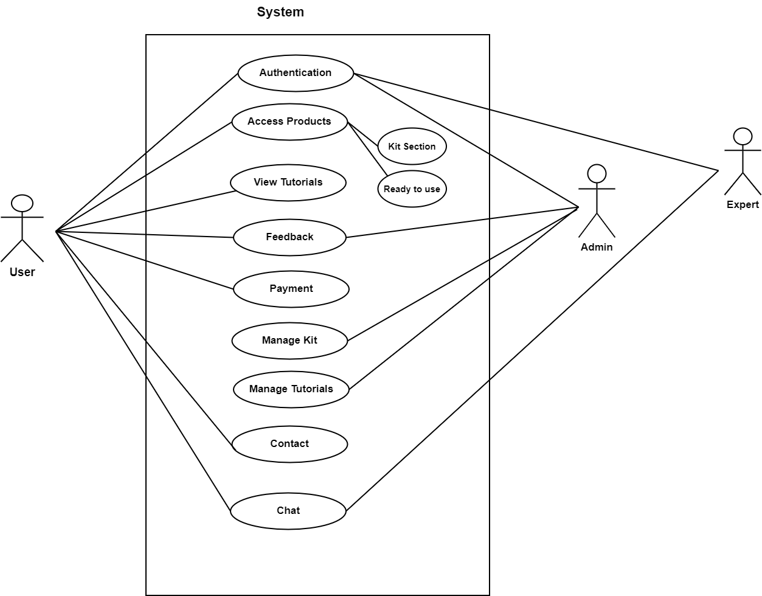
Use Case Diagram

Slide 16
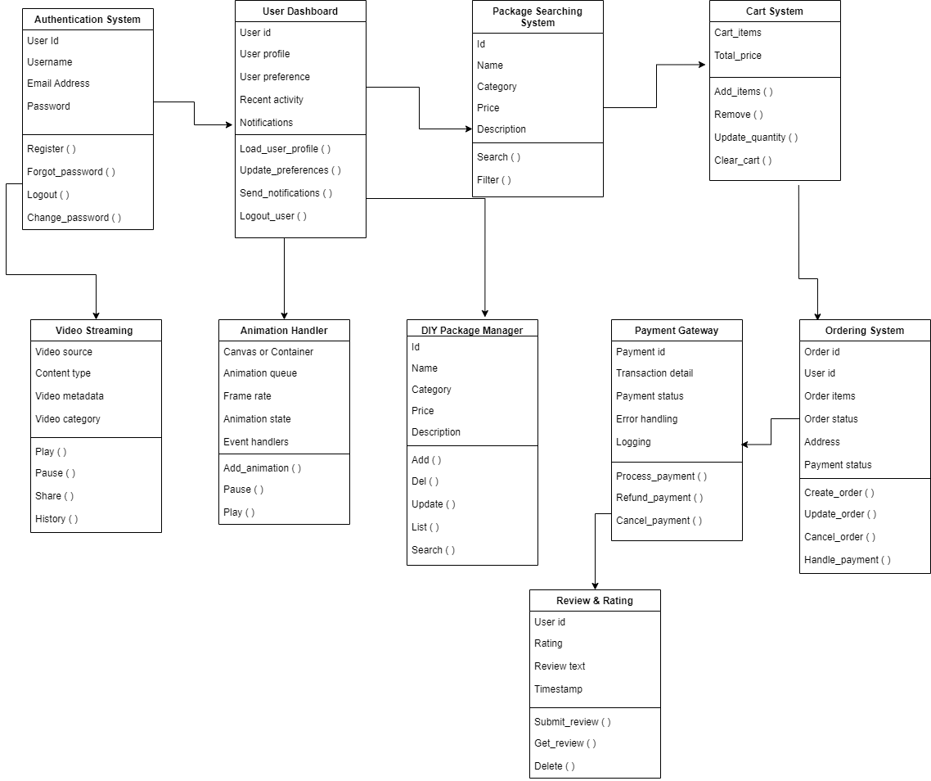
Class Diagram

Slide 18

Conclusion
Overcoming Obstacles
Comprehensive Offerings
Guided Videos
Instant Support

Slide 19
Thank You

